Slide 1
따뜻한 느낌의 친화적 vs 기존의 zoom, discord, webex 와 같이 black베이스

Slide 2
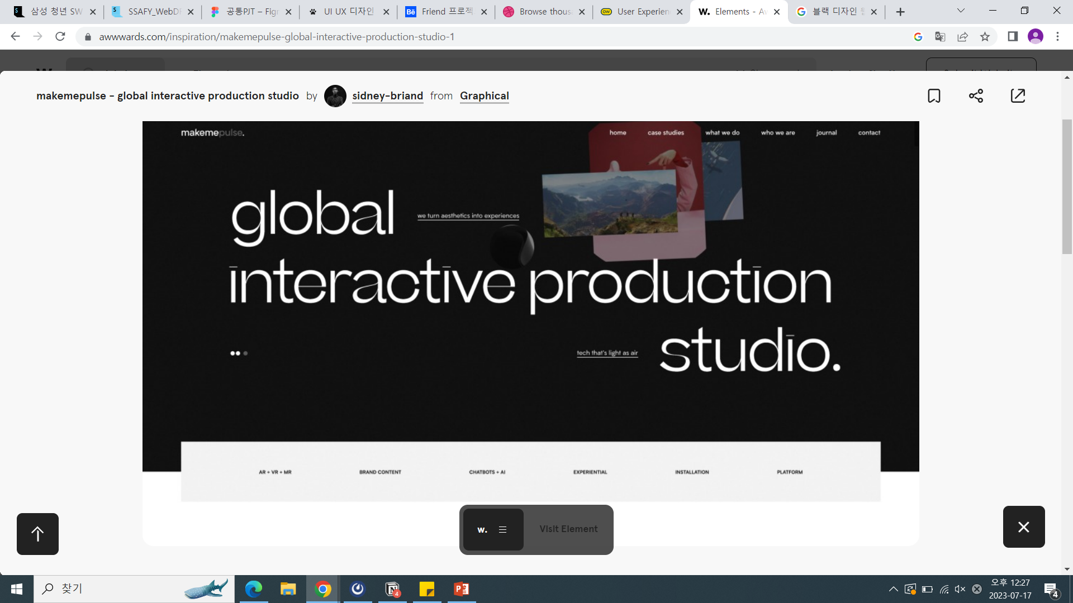
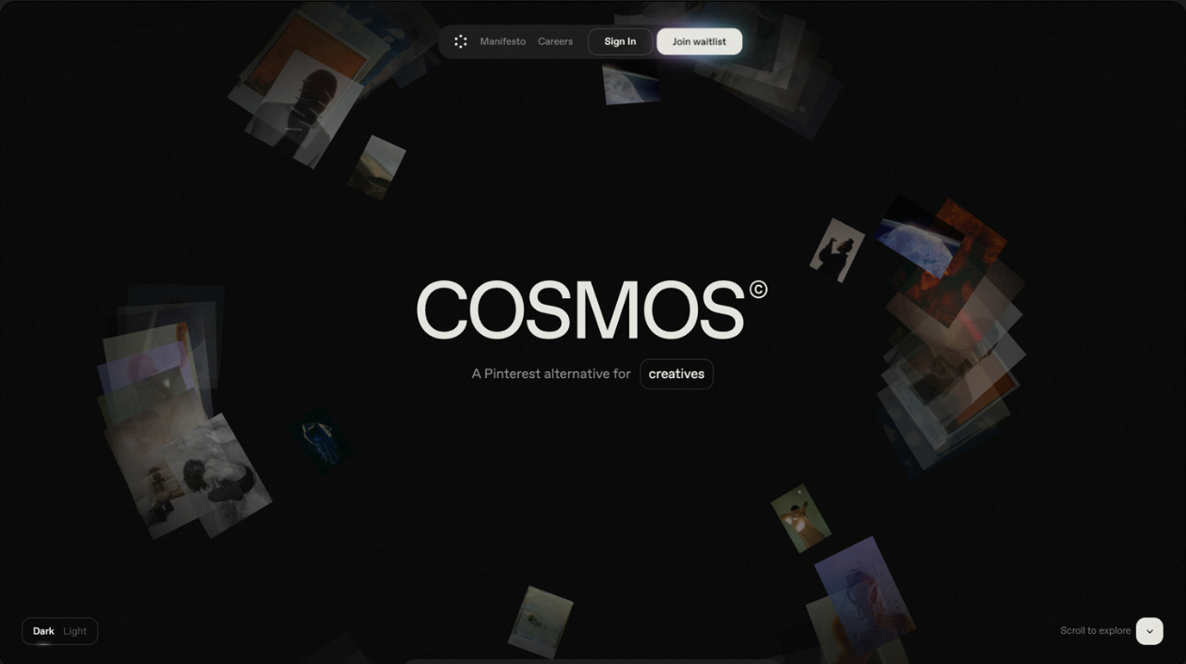
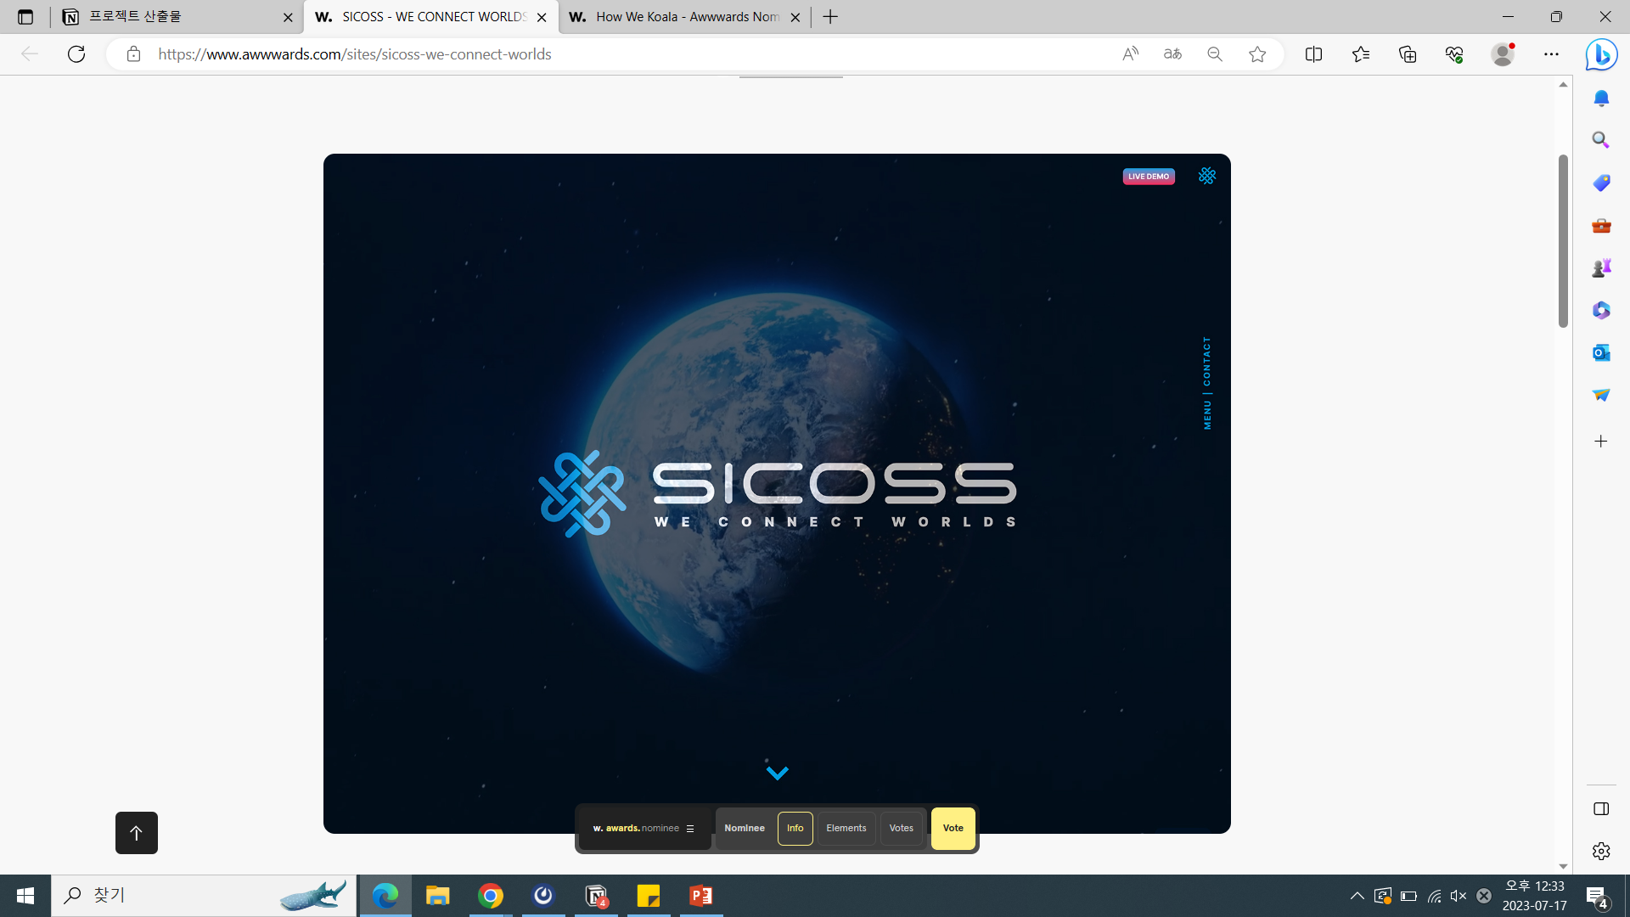
기존의 zoom, discord, webex
black베이스
https://www.awwwards.com/inspiration/makemepulse-global-interactive-production-studio-1
SICOSS - WE CONNECT WORLDS - Awwwards Nominee

Slide 3
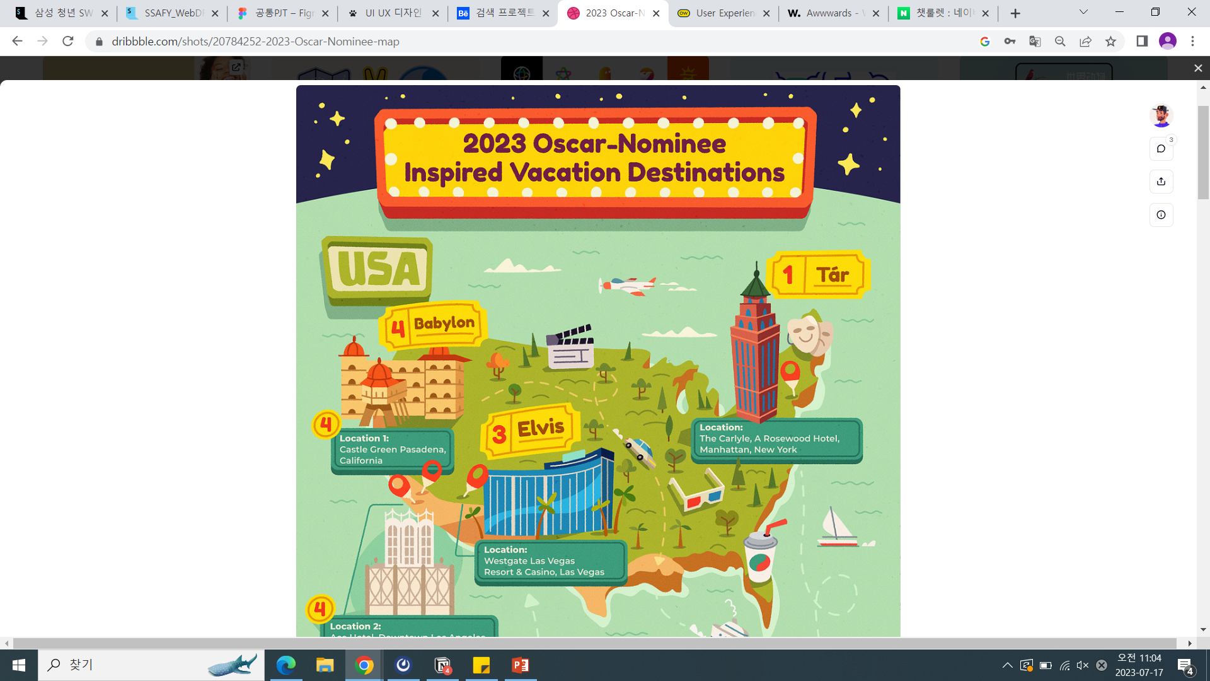
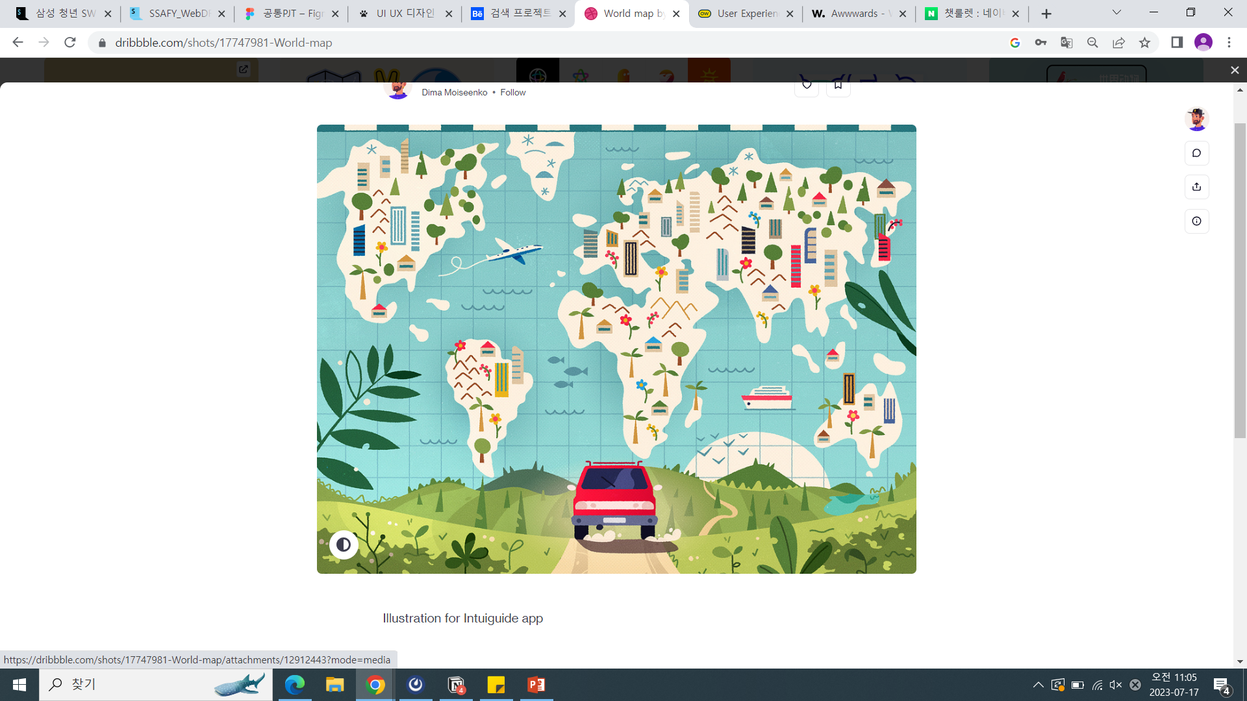
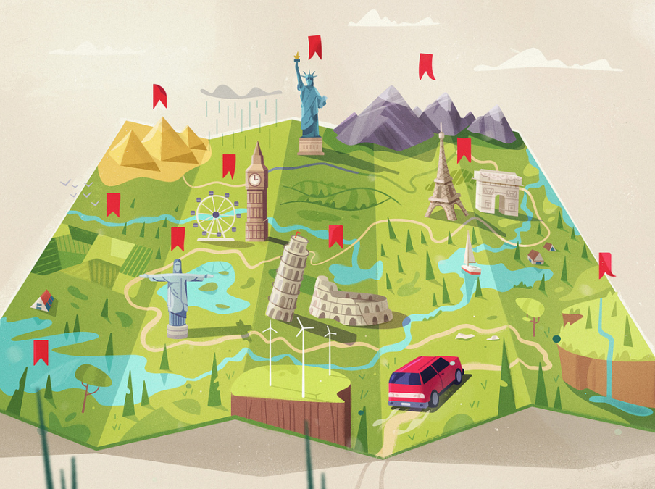
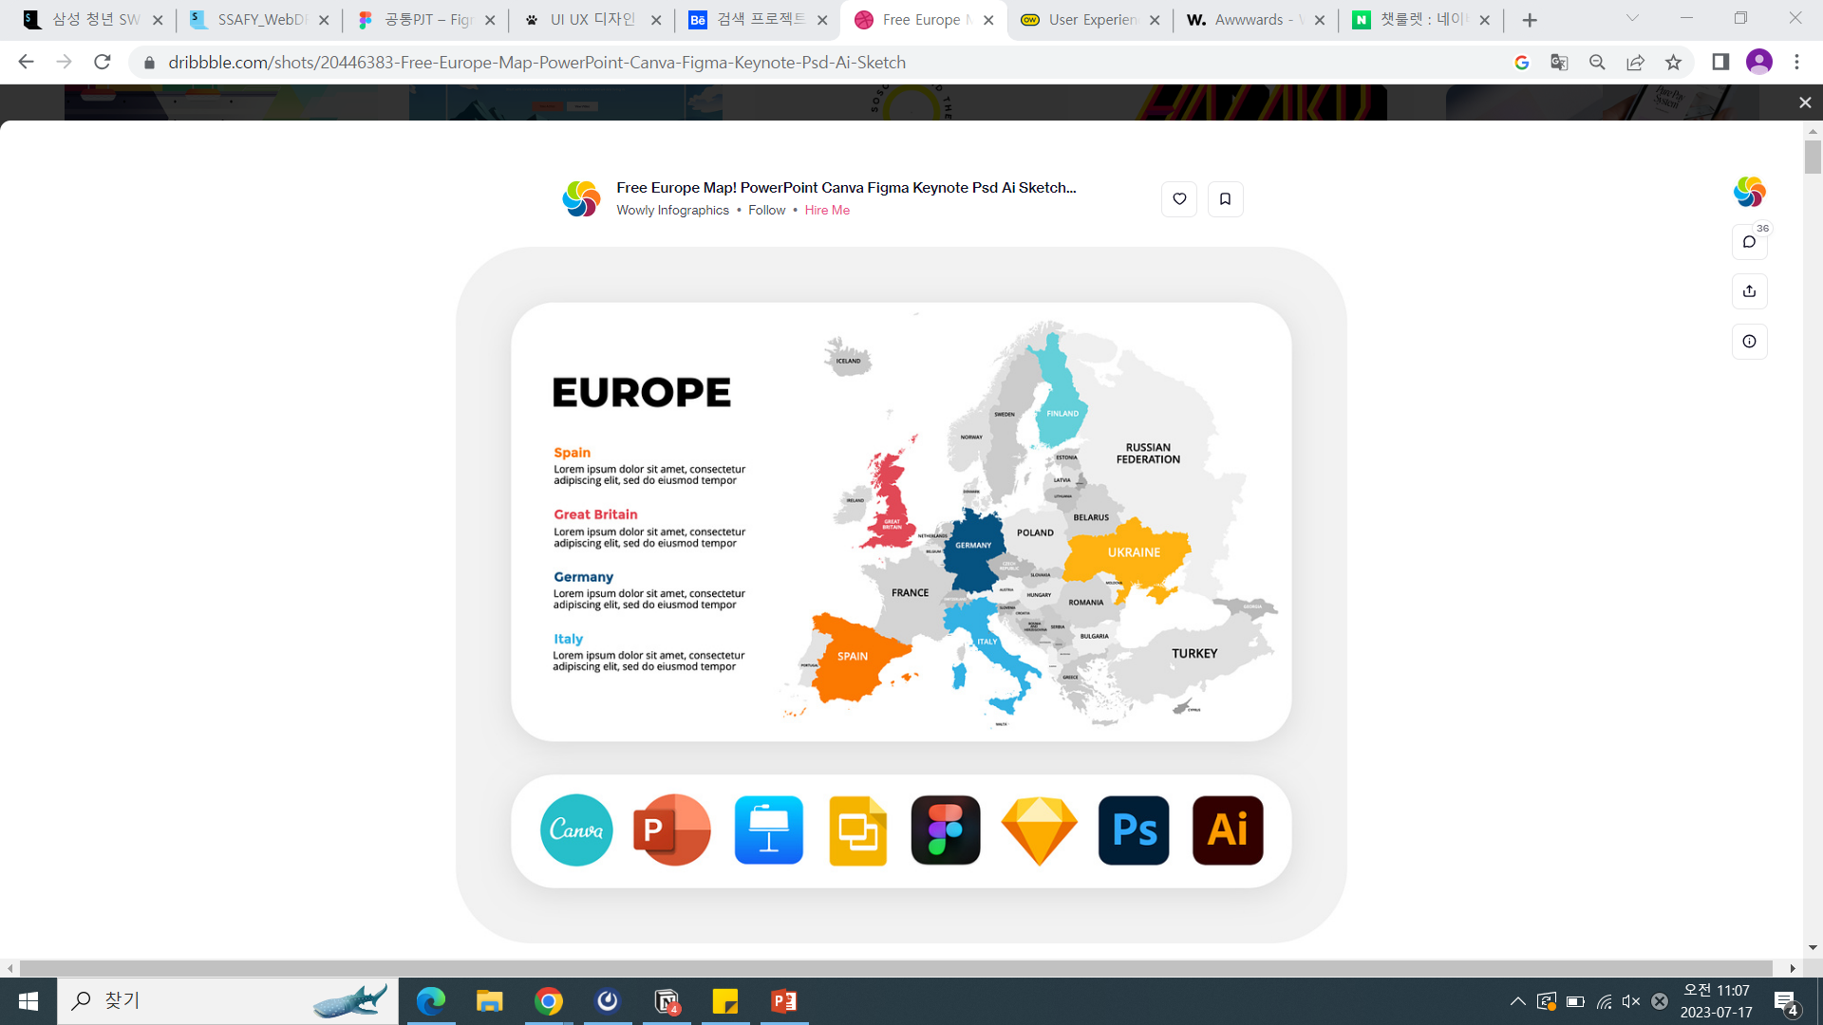
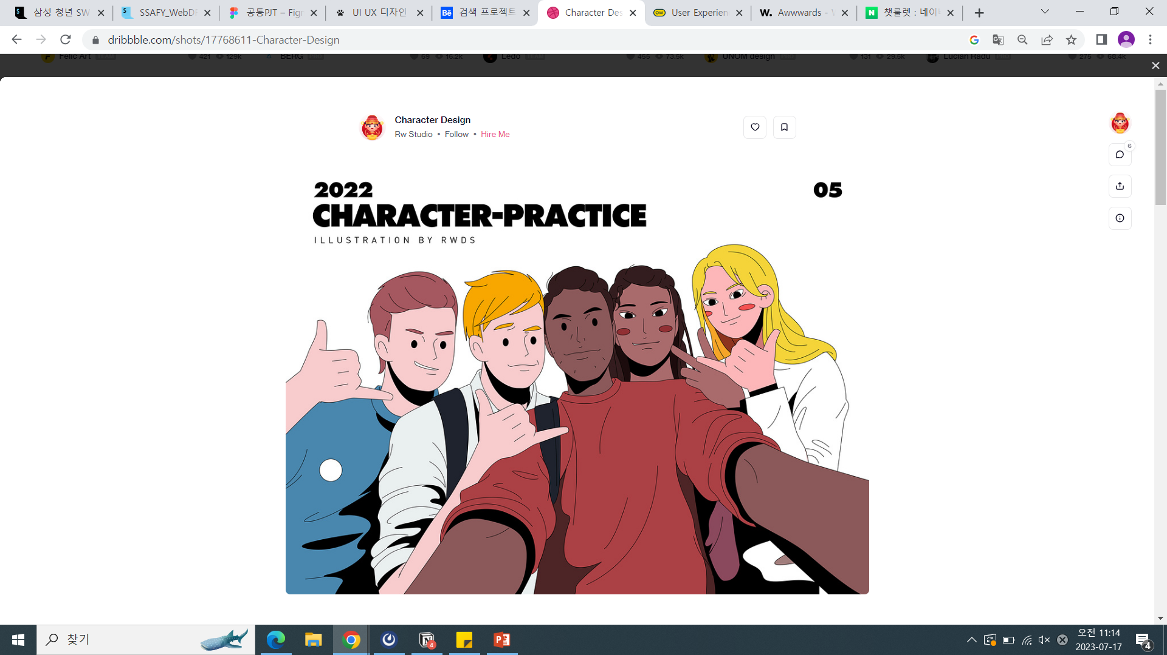
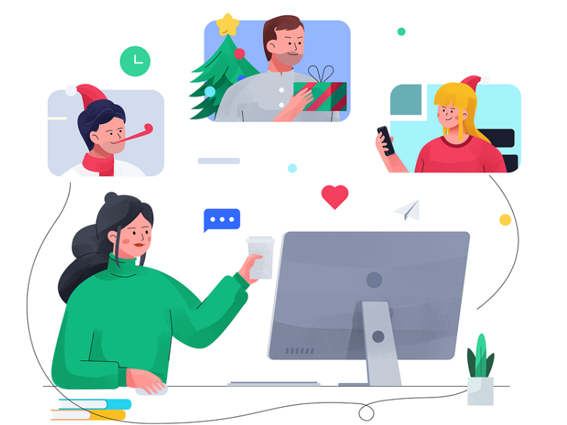
따뜻한 느낌 + 친화적
https://dribbble.com/shots/20784252-2023-Oscar-Nominee-map
https://dribbble.com/shots/15644725-Route
https://dribbble.com/shots/17747981-World-map
https://dribbble.com/shots/20446383-Free-Europe-Map-PowerPoint-Canva-Figma-Keynote-Psd-Ai-Sketch
https://dribbble.com/shots/17768611-Character-Design
https://dribbble.com/shots/17851100-Christmas-work

Slide 4
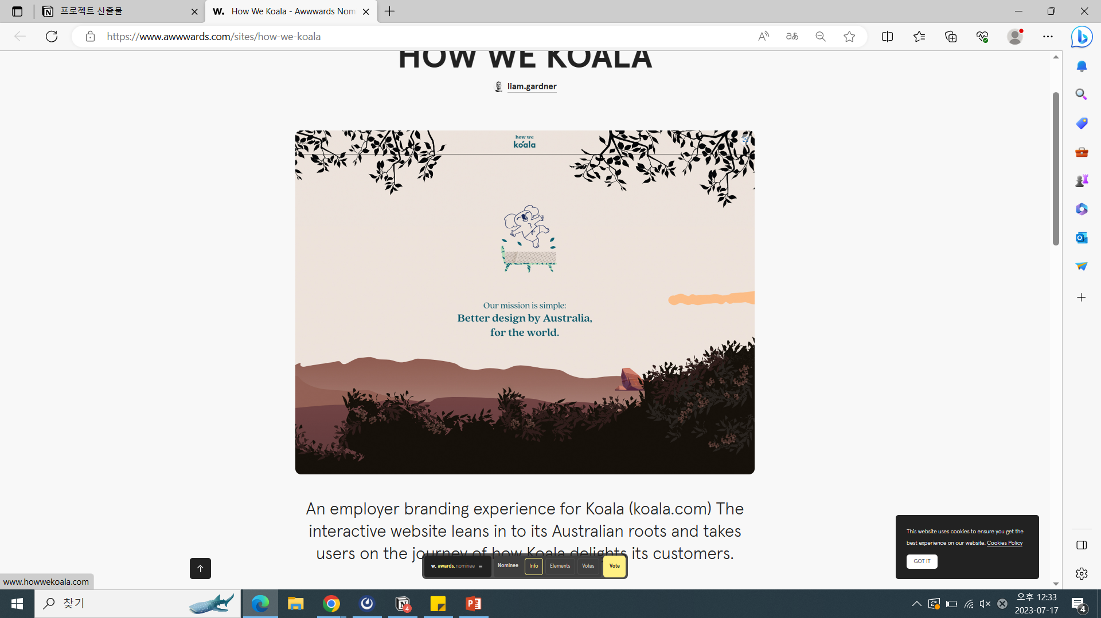
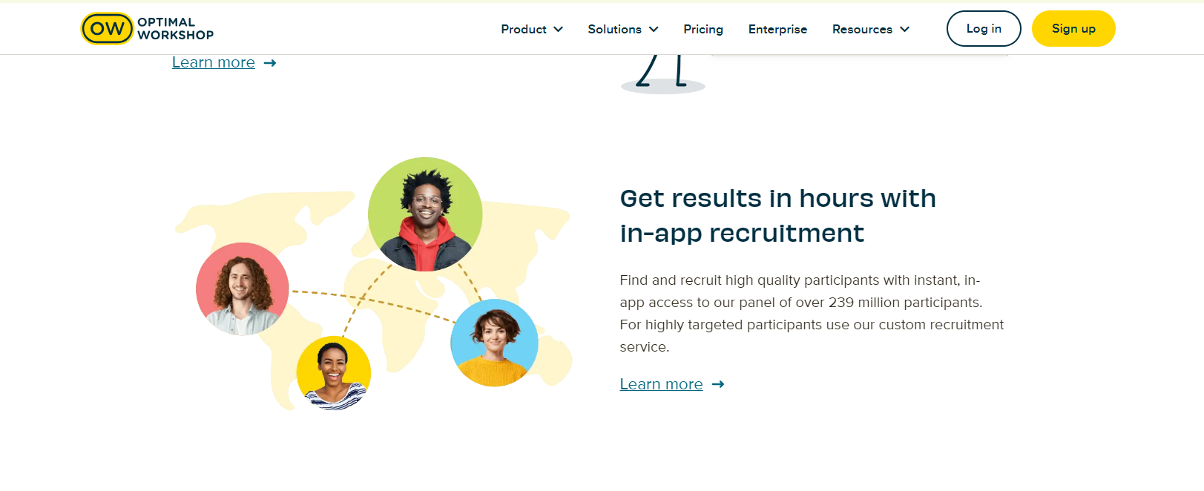
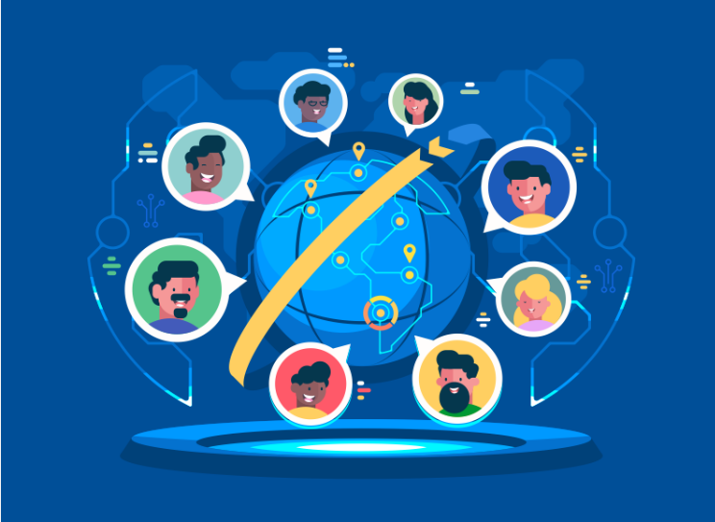
https://www.optimalworkshop.com/?utm_source=dribbble.com&utm_medium=referral&utm_campaign=display_v1&utm_content=brand_v3
https://dribbble.com/shots/4206247-Global-Communication
How We Koala - Awwwards Nominee

Slide 5
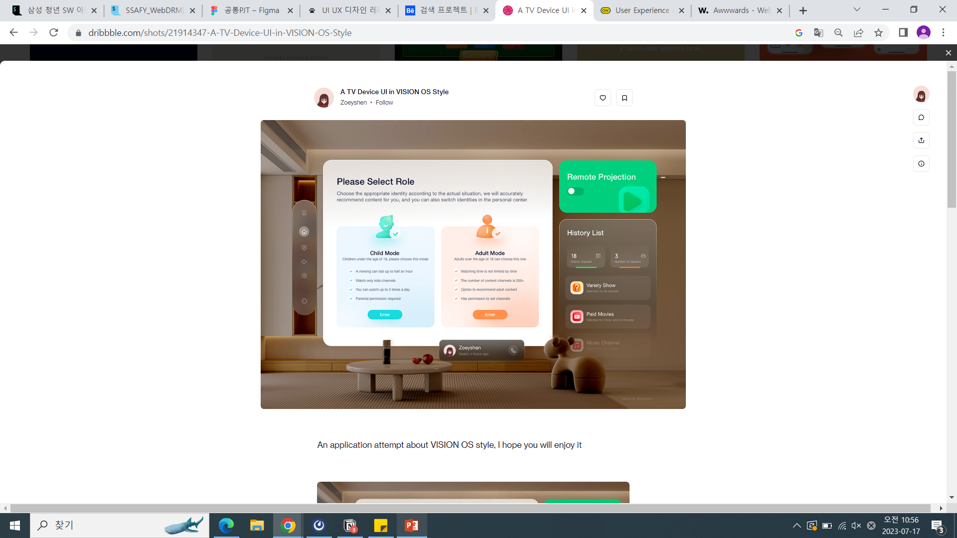
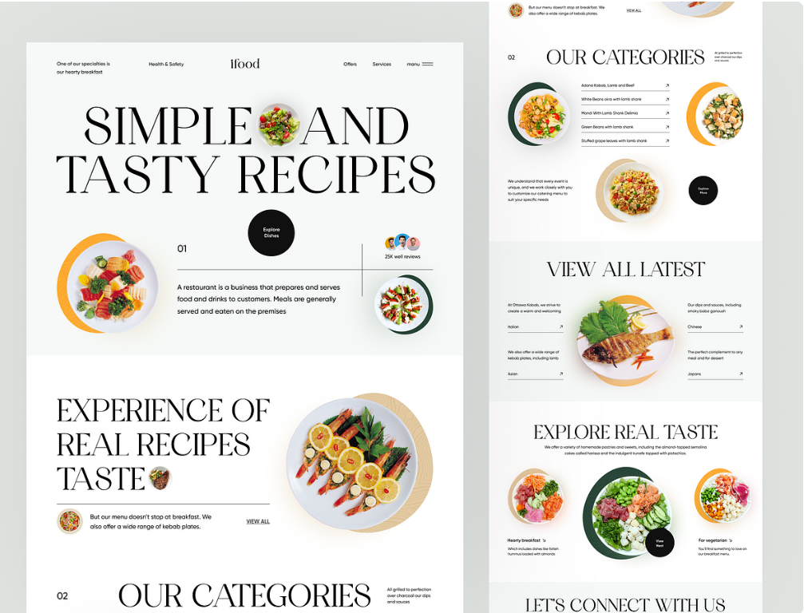
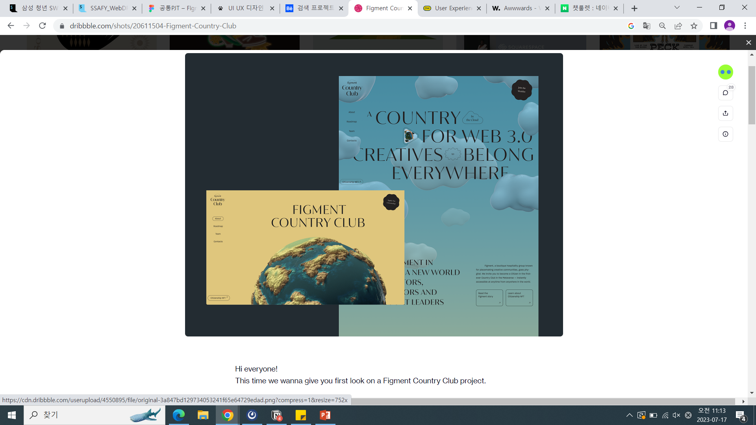
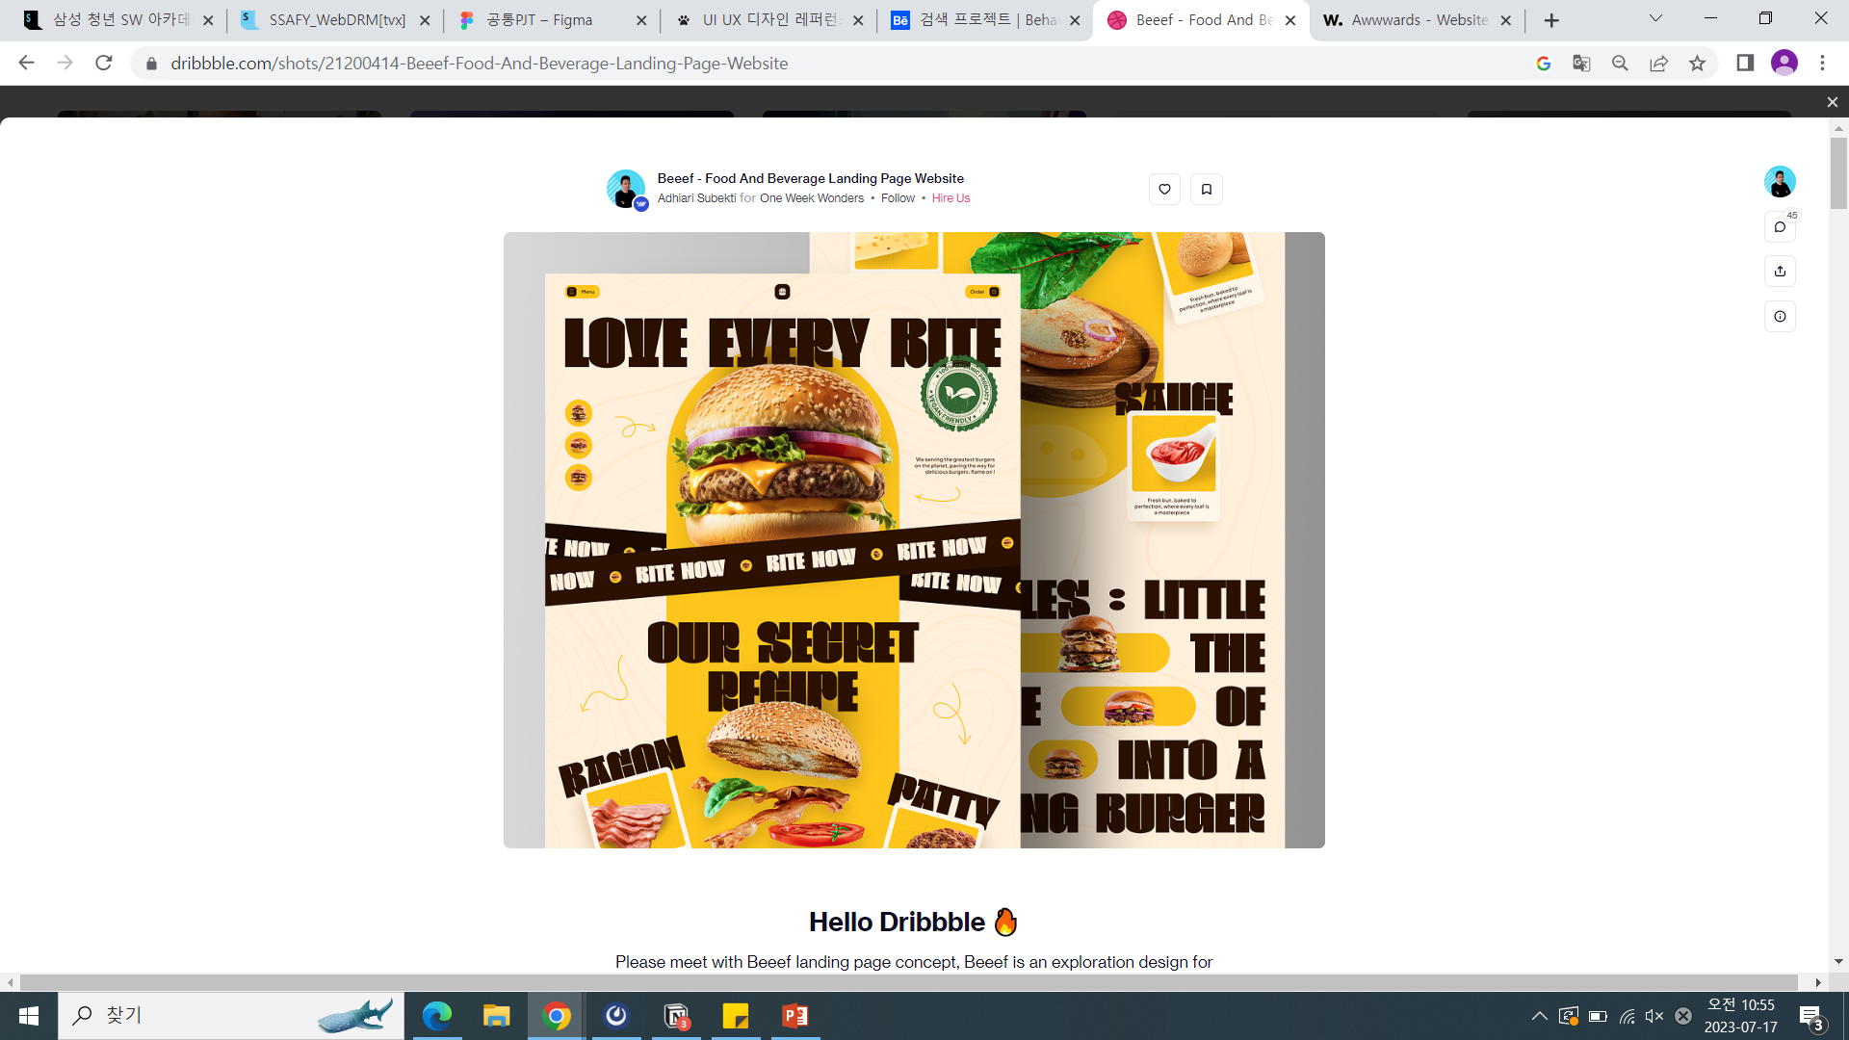
시작 페이지에 페이지 소개
https://dribbble.com/shots/22007304-Restaurant-Website
https://dribbble.com/shots/21914347-A-TV-Device-UI-in-VISION-OS-Style
https://dribbble.com/shots/21200414-Beeef-Food-And-Beverage-Landing-Page-Website
https://dribbble.com/shots/20611504-Figment-Country-Club

Slide 6
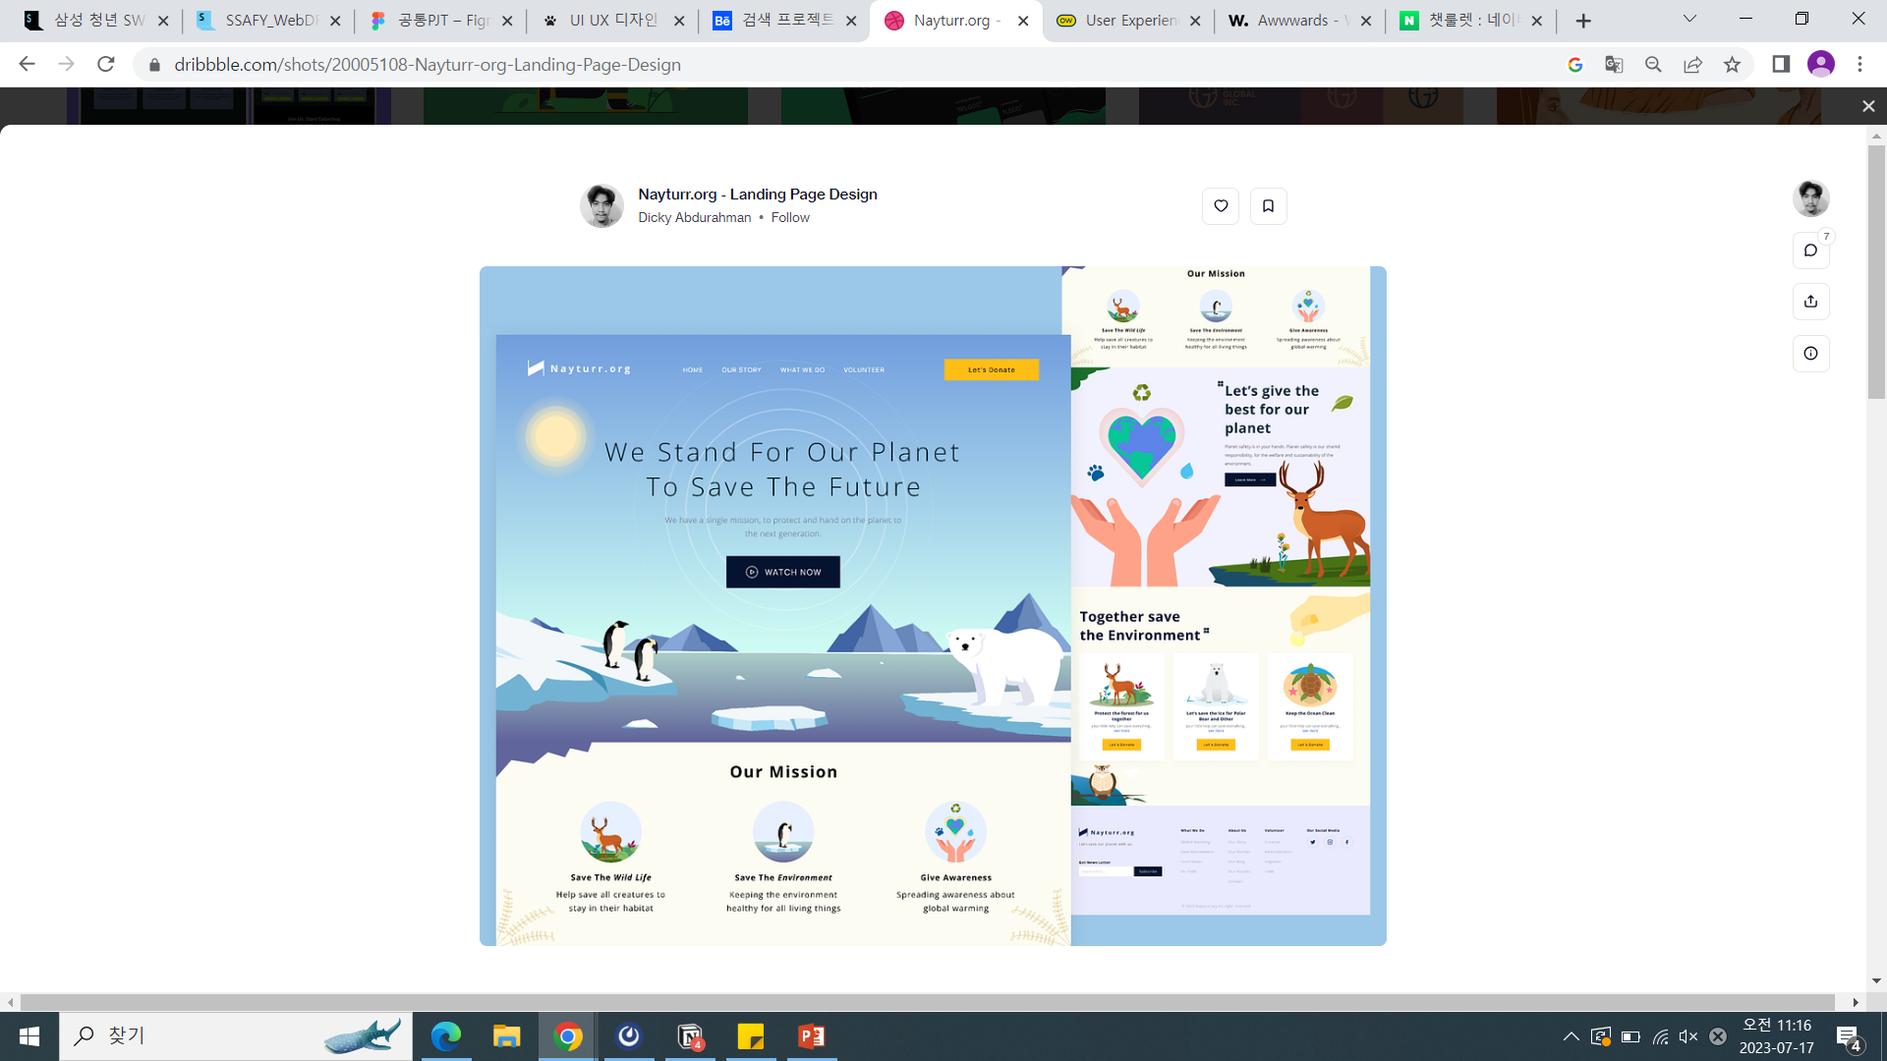
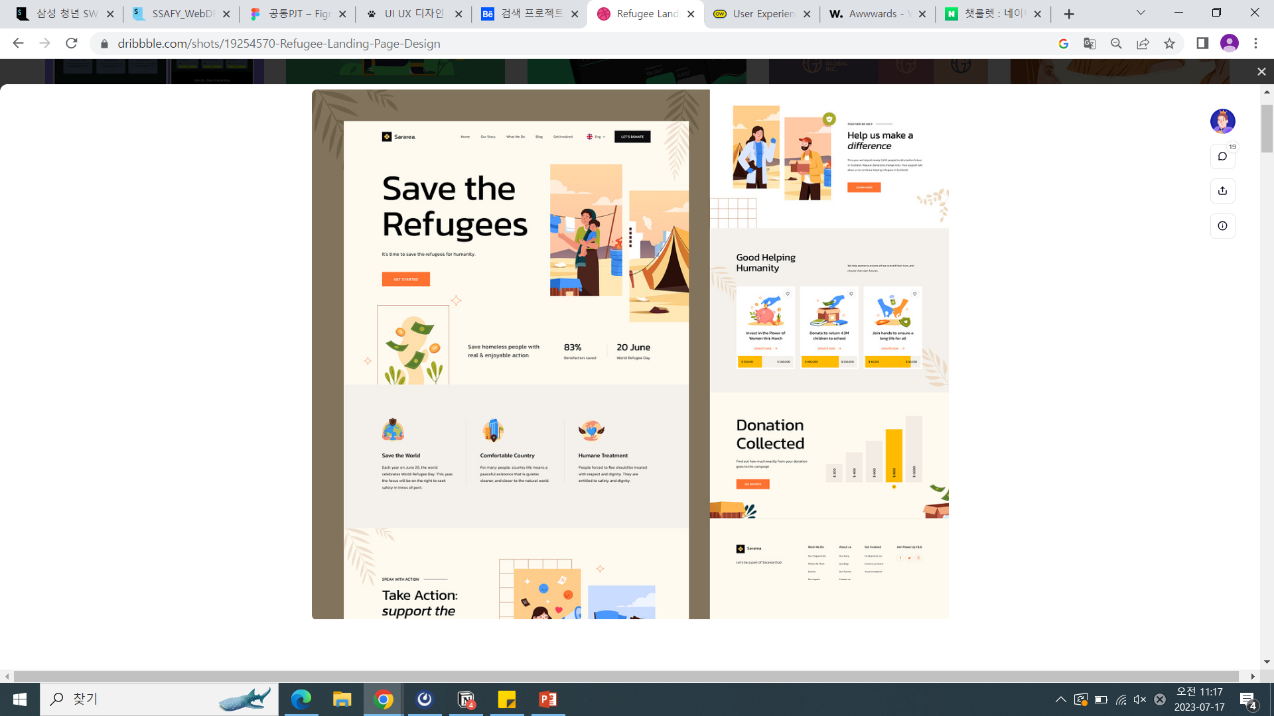
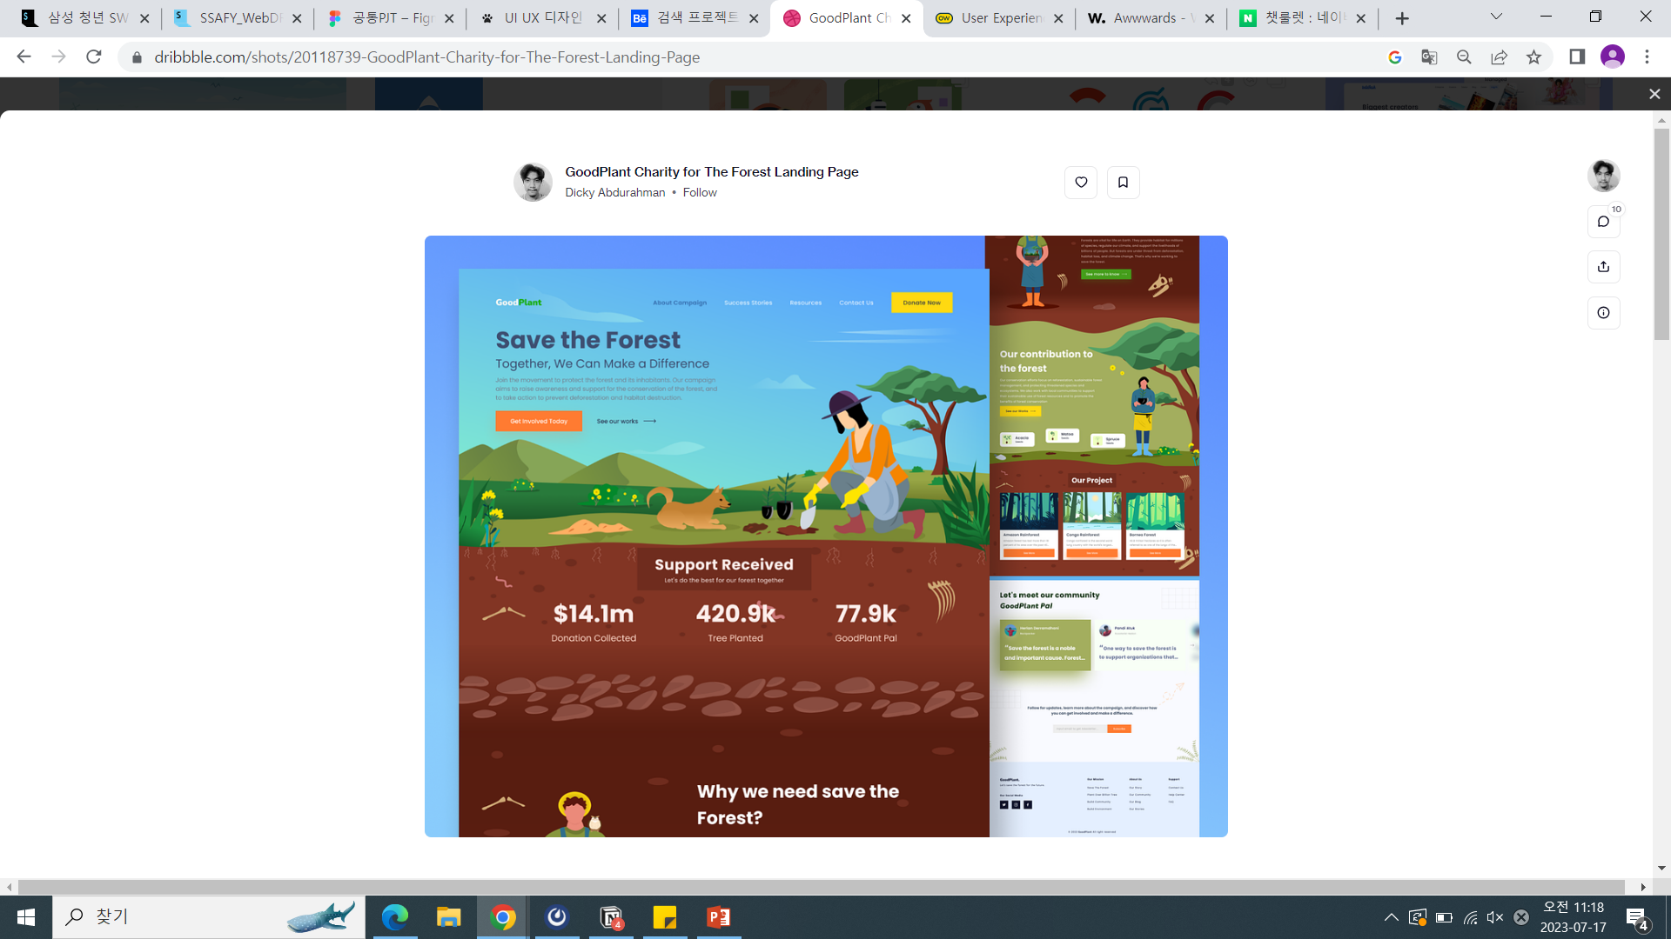
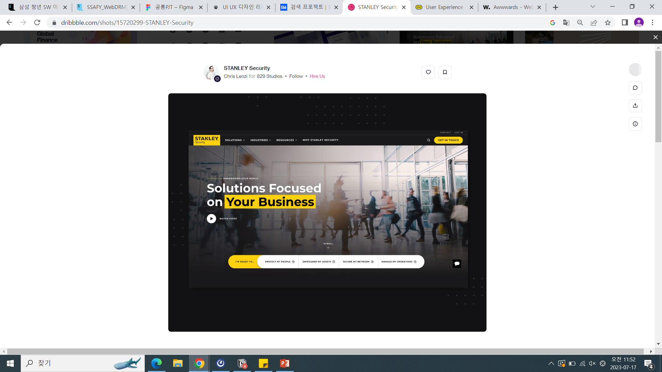
https://dribbble.com/shots/20005108-Nayturr-org-Landing-Page-Design
https://dribbble.com/shots/19254570-Refugee-Landing-Page-Design
https://dribbble.com/shots/20118739-GoodPlant-Charity-for-The-Forest-Landing-Page
https://dribbble.com/shots/15720299-STANLEY-Security

Slide 7
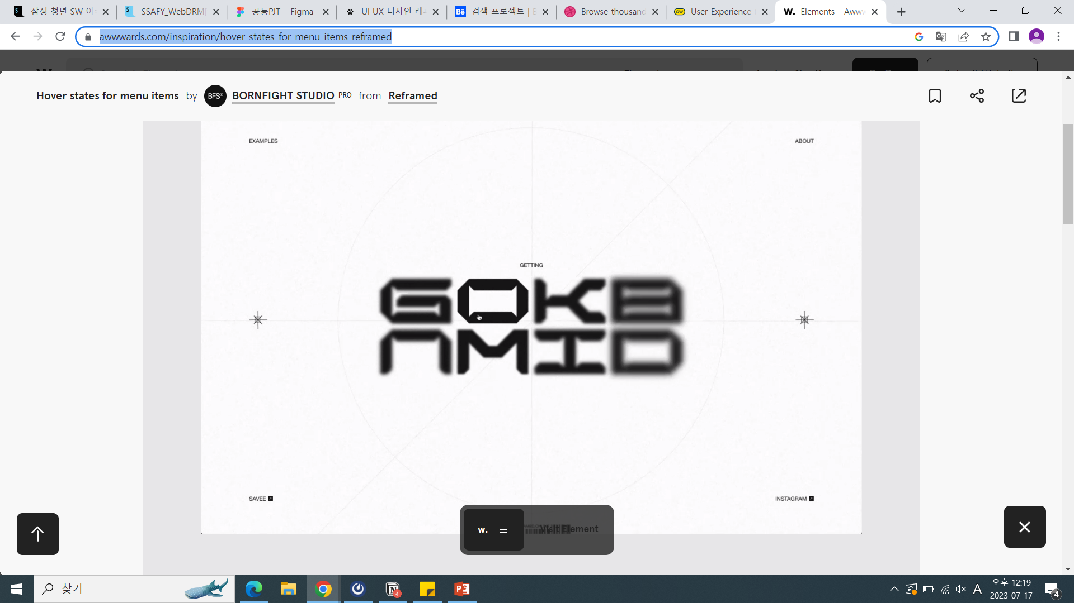
https://www.awwwards.com/inspiration/hover-states-for-menu-items-reframed
언어들 츄르륵 해서 결국은 GLOBAL
참고 사이트
https://wildpuppy.tistory.com/entry/UI-UX-%EB%94%94%EC%9E%90%EC%9D%B8-%EB%A0%88%ED%8D%BC%EB%9F%B0%EC%8A%A4-%EC%82%AC%EC%9D%B4%ED%8A%B8-7%EA%B3%B3
https://www.behance.net/
https://dribbble.com/following
https://www.awwwards.com/

Slide 8
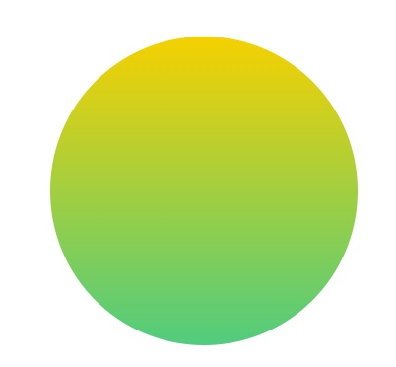
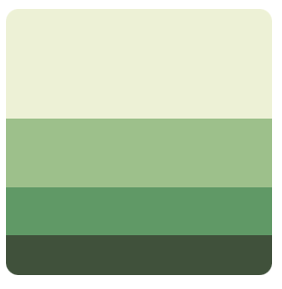
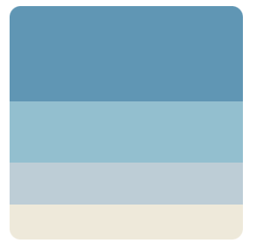
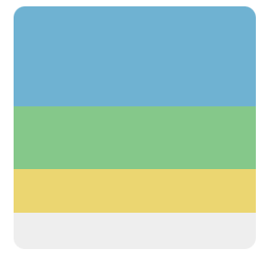
(master)

